Slide 1
Ohm-Wreckers’ Solutions
MD5 Hackathon solution
Members: Ali Maredia, Srikar Nalleuri, Samir Hassam

Slide 2

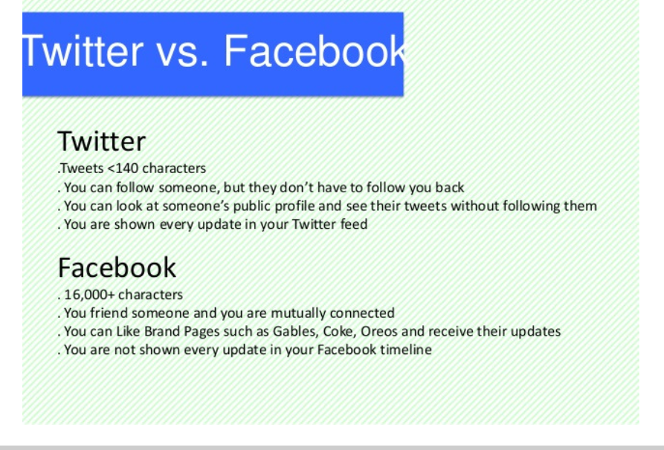
Problem Statement and Observation
First responders are placed in situations of rescuing innocents and tackling tough decisions to retain the code of their duty, while infrastructure continues to crumble and there remains no communication, no resources, and no end in sight
This was not just a dreamt nightmare but a reality that many faced during wake of Hurricane Sandy that made landfall on the east coast in fall 2012
The storm left lasting impressions on the people of 13 counties in the NY/NJ area and left 346,000 homes destroyed or damaged and around $4-5 billion dollars in damage

Slide 3
Proposed Solution
Collecting raw data extracted from the public social media domain whereby posts are sorted by particular key words or phrases
The issue that we wish to address is gathering the information sourced from social media that act as a crowd-sourced database of dynamic information that can improve ground operations for search, rescue, and recovery

Slide 4





Solution Methods and Resources
Use of the APIs allowed for the completion of a model process shown in the simulation ran by our computers using the JSON components
Google Maps API
Twitter API
MongoDB
Amazon Web Services
Digital Ocean Servers

Slide 5
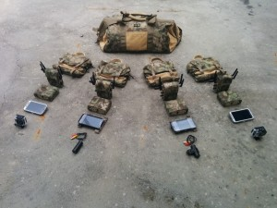
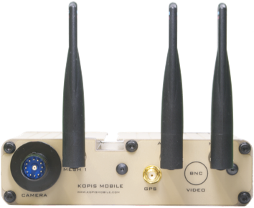
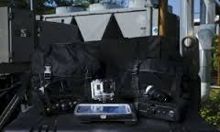
Alternative approach to adjusted situation
The adapted solution for the case that a reliable network is not available is the use of a technology created by Kobis Mobile.
Kobis Mobile- company the provides reliable, portable technology for the proper collection and re-evaluation of audio, video, and photo sources
Kopis tactical gear and accessories
Kopis’ Network Tactical tv module
Kopis ESRA product

Slide 6
Realization of Methods

Slide 7
Cost/Benefit Analysis
Overview of various expenses that can be incurred if the necessary need and capacity arises
This current moment expenses are limited to about $78/year (including all operation costs)
Includes the use of a domain and smaller web-server
Company Names | Amazon Web Services | Twitter API (enterprise package) | Kopis Mobile LLC | IBM Watson Services
Number of products/Services purchased | Lambda or Kinesys server- (1) | Package use-(1)* | Tactical Mobile System + MC package (2) | 1 or 2*
Cost of using such things | +$100 (attained credit) | Provided upon request | $1413.25 | $20.00/(n-1) classifiers and $0.0035/(n-1000) calls
*Services could potentially be used in the future for greater datasets

Slide 8
Formulated Model/Design
The following presentation will demonstrate some of the data that we collected and the process by which a simple query can sprawl out and gather an active user base
The demonstration includes two components: a demonstration of our software application (primary solution) and a overview of our hardware design (secondary solution)

Slide 9
Strategic Conclusions

Slide 10
Cited Sources and Documentation
Google Maps API- Google Maps JavaScript API | Google Developers. (n.d.). Retrieved February 24, 2017, from https://developers.google.com/maps/documentation/javascript/ Utilized to create map overlay of data using the Google Maps custom layout and tools
Twitter API- T. (n.d.). REST APIs — Twitter Developers. Retrieved February 24, 2017, from https://dev.twitter.com/rest/public Congregated the information gained from the live twitter feed to report specific trends and events occurring within specific regions
Bootstrap- Buytaert, D. (2016, August 29). Bootstrap Library. Retrieved February 25, 2017, from https://www.drupal.org/project/bootstrap_library Sourced this library to use the tools that created a desirable user interface
Socket.io- M. (2017, February 22). Socket.io. Retrieved February 24, 2017, from https://github.com/socketio/socket.io Used to interface between the JSON configuration and the web-server to source scripts and commit actions
jQuery- Jquery.org, J. F. (2017). JQuery API. Retrieved February 26, 2017, from http://api.jquery.com/ Provided a dynamic library to execute commands that created a more visible and dynamic interface
Vex- N. (2017). Vex-js. Retrieved February 26, 2017, from https://www.npmjs.com/package/vex-js Included the formatting properties of the Javascript structure to take into account the addition of html elements
Twit- Twit-old. (n.d.). Retrieved February 25, 2017, from https://www.npmjs.com/package/twit-old Used to structure the api information sourced for our problem solving method with the twitter api

